Slide 1
Incorporating cost-benefit analysis of REDD+ options into planning for REDD+ in Cambodia
Mr Chivin Leng, Forestry Administration of Cambodia,
7 December 2015

Slide 2
National objectives for this work
Key questions:
How much will it cost to implement REDD+?
How are costs and benefits of REDD+ and alternative land uses distributed among different stakeholders?
What are the costs and benefits between REDD+ options and different land uses in a specific landscape?
What are the benefits flowing from forests in Cambodia, and how could REDD+ help secure these?

Slide 3
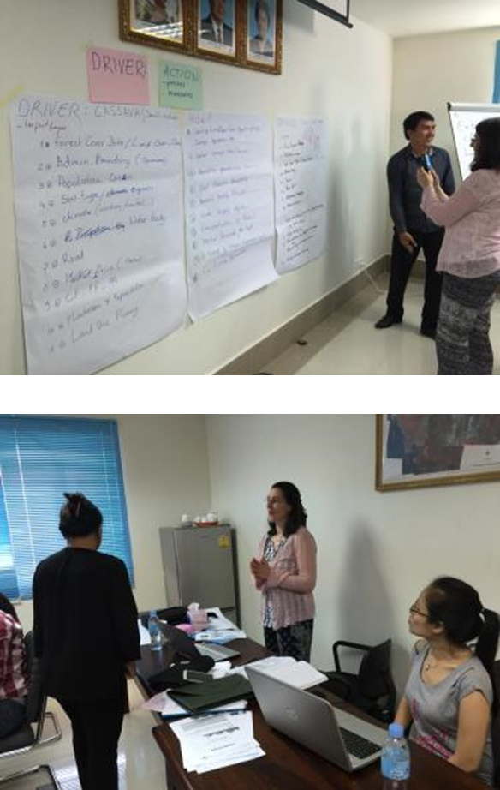
The analysis: activities
Develop costs-benefits analysis tool (Excel-based)
… with data from national level, and from two provinces (Koh Kong & Mondulkiri)
GIS tool to combine spatial and economic data - in progress
Build capacity among Cambodian partners to develop and use the tools
Use results to inform REDD+ planning (e.g. development of National Strategy)

Slide 4
Cost-benefits analysis spreadsheet tool
Quantifies and compares the costs and benefits of different REDD+ options and alternate land uses over 25 year period
Costs of REDD+
Benefits of REDD+
Opportunity costs (foregone profits from alt. land use)
REDD+ income
Forest benefits (e.g. timber, NTFPs)
Implementation costs
Ecosystem services (e.g. water regulation)
Transaction costs

Slide 5
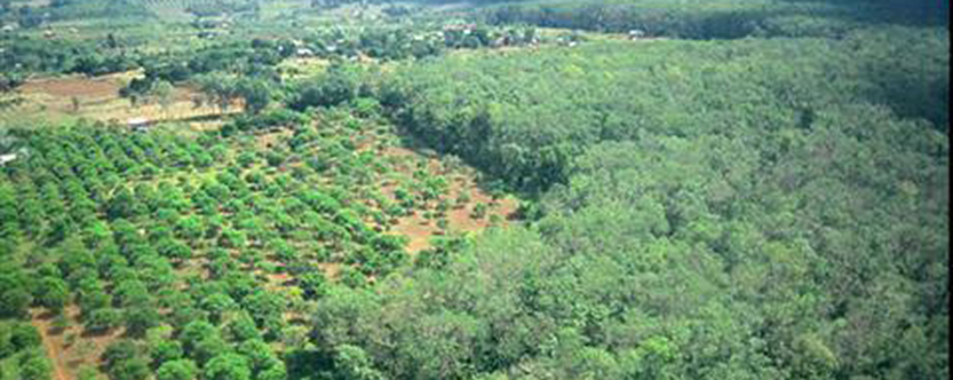
Spatial decision support tool – in progress
To aid the prioritization of land areas for REDD+, based on potential economic gain and additional benefits
  Identify driver of land cover change
  Identify REDD+ action
  Prioritize land areas for potential inclusion in REDD+
Natural
Forest
Cassava
Plantation

Slide 6
How can the analysis help answer our key questions?
How much will it cost to implement REDD+?
  Estimates implementation costs of five REDD+ options for Cambodian context over 25 years
  Estimates opportunity costs for main alternative land uses
  Estimates national transaction costs
  Allows user to compare costs of options to each other and to alternative land uses

Slide 7
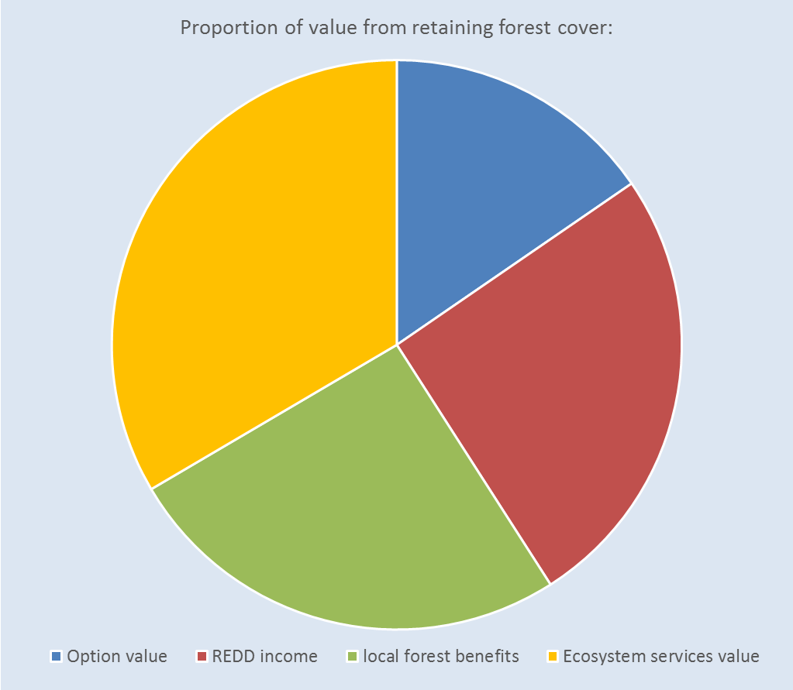
Basic cost-benefit analysis worksheet:
Notes:
Content – driver of interest, over what area, which option to tackle that driver, output is an estimate of what carbon saving might be & basis econ analysis of value of forest cover as opposed to value of alternative

Slide 8

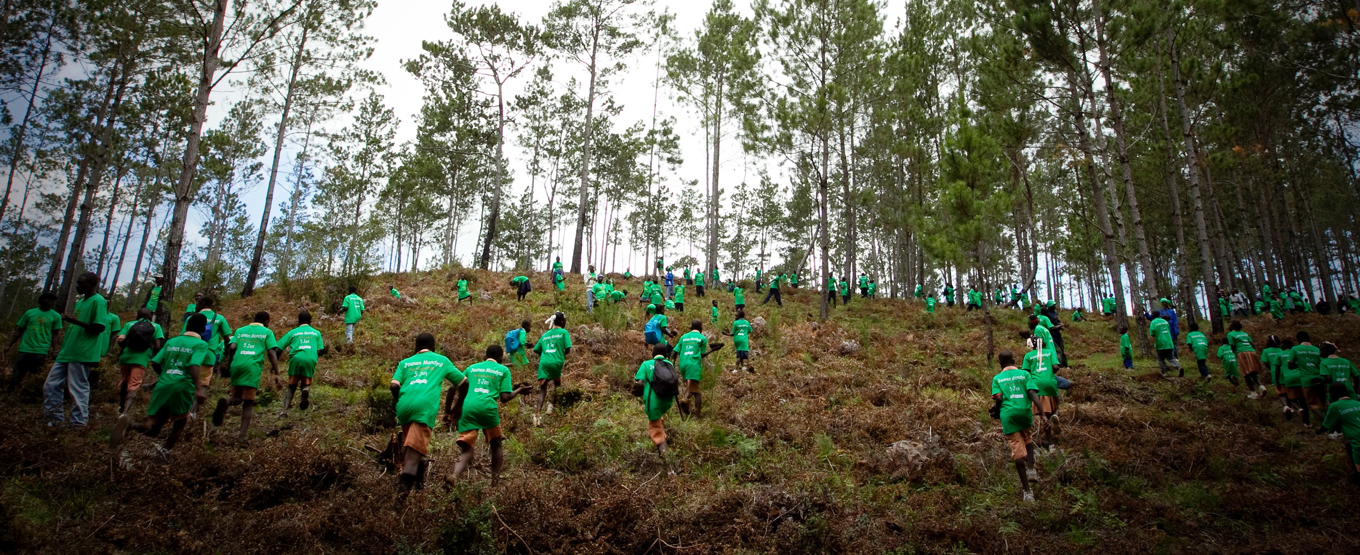
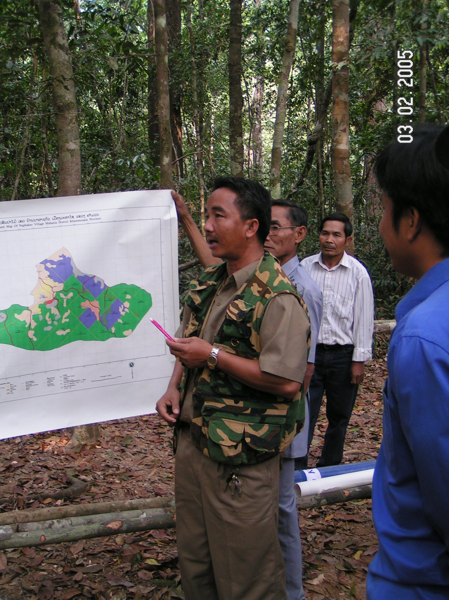
How can the analysis help answer our key questions?
How are costs and benefits of REDD+ and alternative land uses distributed among different stakeholders?
  Presents costs and benefits of REDD+ options according to community, government and overall national perspectives, over a 25 year period

Slide 9
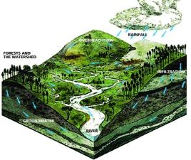
Bringing economic and spatial information together
Combined economic-spatial decision support tool will allow user to select a driver of land use change and a REDD+ option
Explore distribution of costs and benefits in a landscape, including ecosystem services

Slide 10
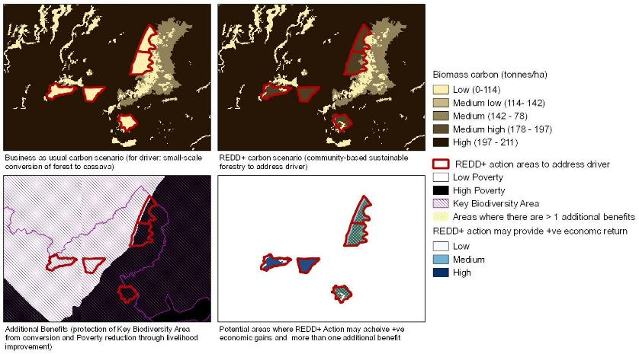
Intermediate results show area where REDD+ option can be implemented, along with potential carbon benefits, areas with economic gains and loses, and distribution of additional benefits (e.g. biodiversity areas and poor communities)
Notes:
Intermediate results of spatial tool, illustrating an analysis, combining spatial & econ information – what difference does REDD+ action make?
Comparing BAU carbon losses, the impacts of REDD+ action (community forestry) and some of the additional benefits that would be present in the areas

Slide 11
Summary
Economic analysis provides input for REDD+ planning
Must be tailored to local context and designed to answer specific policy questions
Combined with spatial analysis, can help planners and stakeholders to
  Analyze the suitability of different areas for different types of REDD+ actions
  … aiming to reduce costs and enhancing benefits, and
  … balancing different land uses across a landscape

Slide 12
Thank you!

